Slide 1
Swarm Intelligence
Presented by: Parikshit Maini Sudeep Gupta

Slide 2
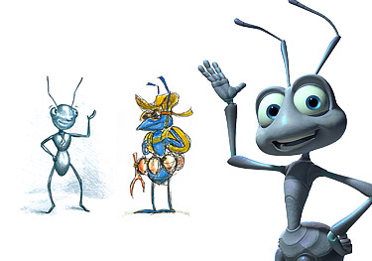
How Understanding Flocks, Schools and Colonies
Can Make Us Better at Communicating,
Decision Making and Getting Things Done.
-Peter Miller

Slide 3
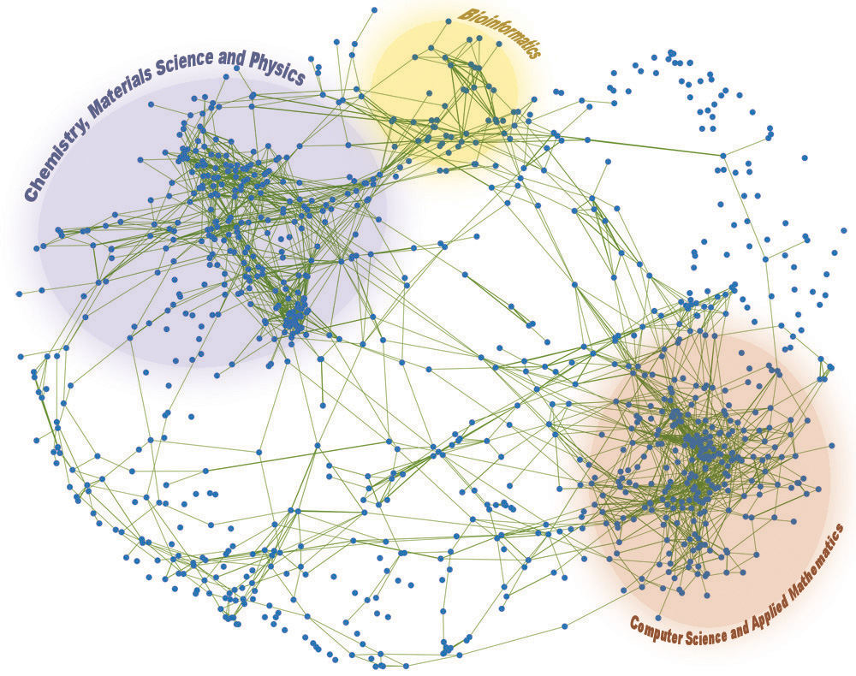
The need – why SI ?
The size of problems today is increasing.
From big to HUGE
The new buzzwords:
Distributed Systems, Cloud Computing
Why not consult the experts!
Notes:
computing power is limited.
distributed computing and cloud computing have become the hot favorites today.
When you are moving towards decentralization, a kind of a multi agent system- then why not turn to the experts!

Slide 4
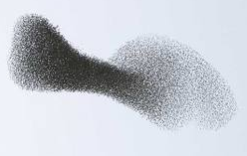
Who are these experts?
They do it for food.
They do it for house hunting
They have done it for centuries.
That is how they have been taught to take decisions.
Who are they?
They are everywhere around us: they are not ants, bees, fishes or starlings!!
They are “the swarms”.

Slide 5
What is SI?
The emergent collective intelligence of a group of simple (rather dumb) agents.
Algorithms and/or distributed problem solving agents inspired by the behavior of social insect colonies and animal societies, which have evolved over the centuries.
The productivity of the swarm is better than the sum of the agents’ single activities.
Notes:
ants solve complex tasks by simple local means
ant productivity is better than the sum of their single activities
ants are

Slide 6
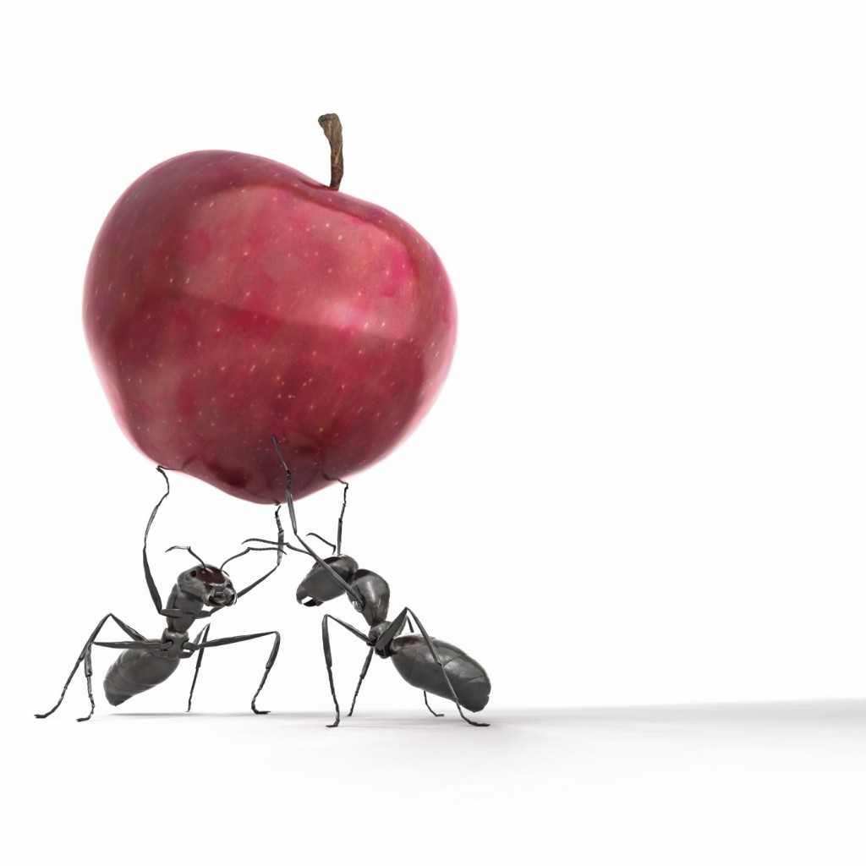
Learning from the Nature

Slide 7
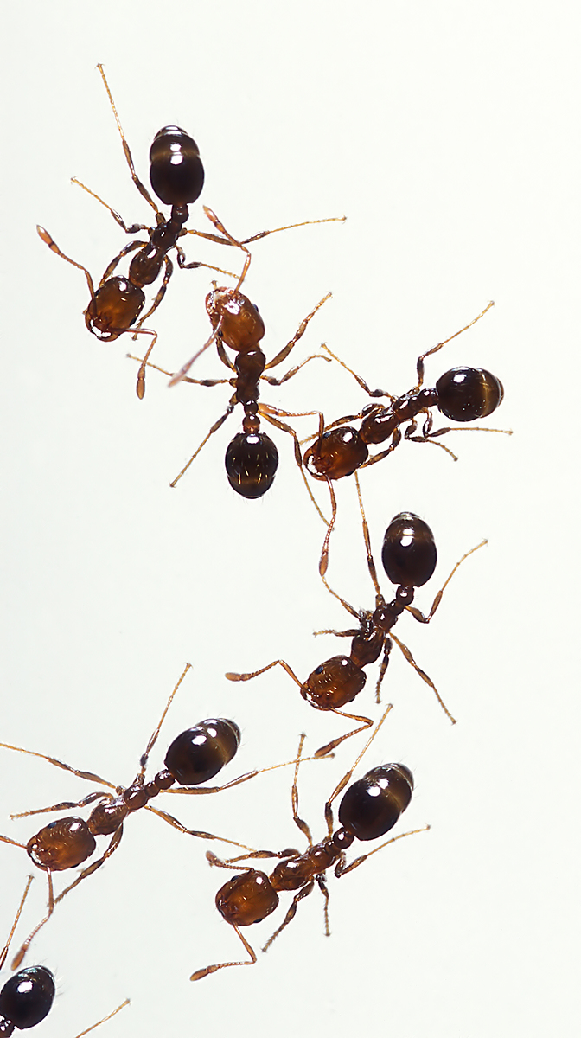
Ants
Find the shortest path

Slide 8
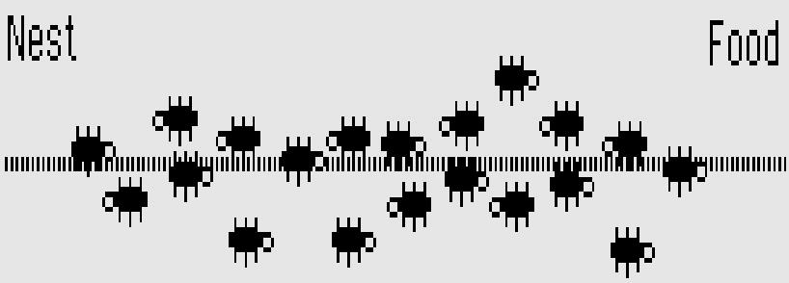
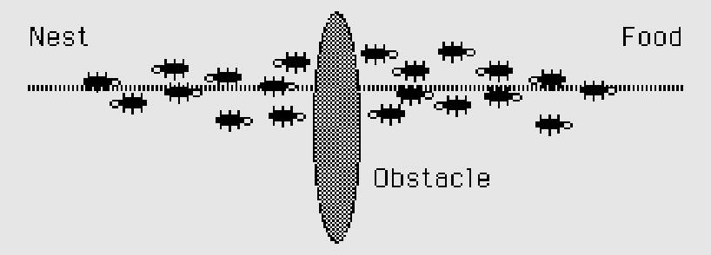

Slide 9
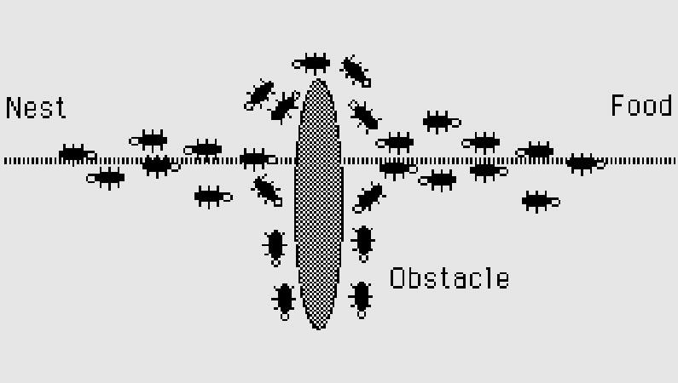
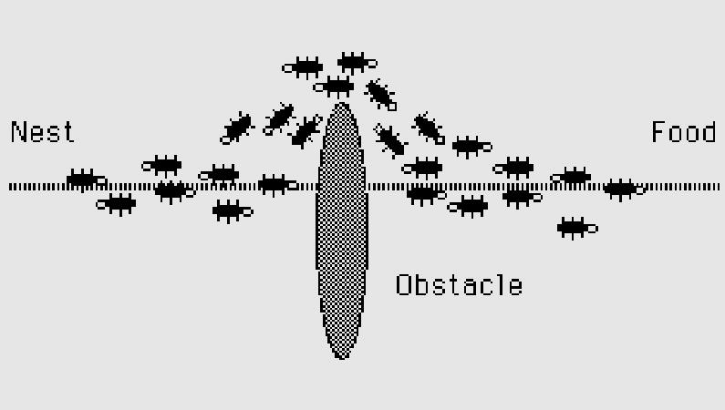

Slide 10
Ants
Find the shortest path
Form a bridge with their own bodies
Tell other ants about a predator
Miss an outing on a rainy day
Ants are ‘grand masters’ in search and exploration.
And they do it without a LEADER
Ants are ‘not’ smart, “ant colonies” are!!
Notes:
They cannot talk. Get to pheromones.
They do not have brains, there’s no space.

Slide 11
The 1st Principle
Self – Organization
How it is achieved:
Decentralized Control
Distributed problem solving
Multiple interactions

Slide 12
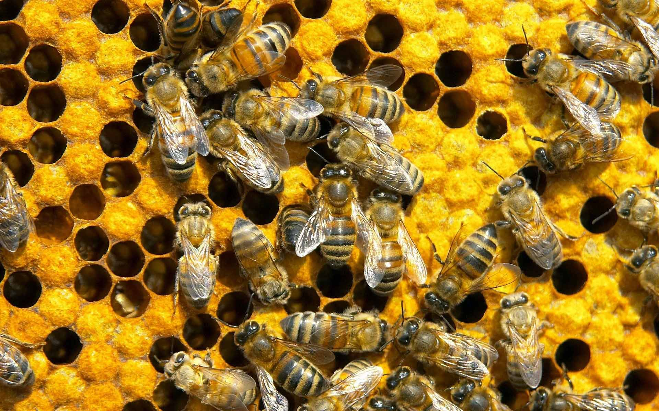
Bees
Communication : Food sources are exploited according to quality and distance from the hive
House Hunting
Efficiency via Specialization: division of labor in the colony
How do they talk?
No, the buzz sound is not what they comprehend.
They DANCE!!
Notes:
Waggle Dance

Slide 13
The 2nd Principle
Diversity of Knowledge
A hundred opinions. (ex. Audience poll, 5-box test)
Being Democratic
Being ‘truly’ Democratic !!
Notes:
Hillary Clinton example, no reputations self check before giving support, without influence

Slide 14
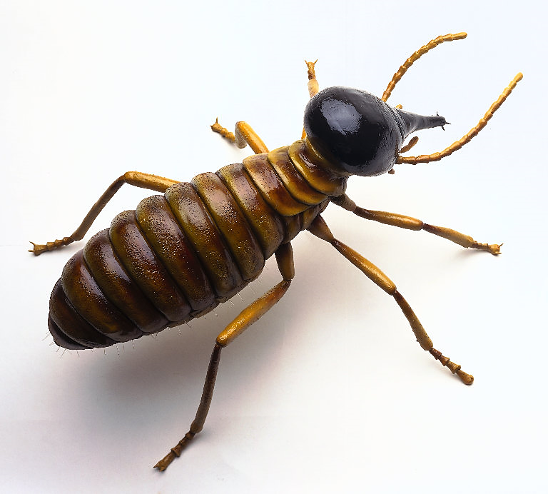
Termites
Cone-shaped outer walls and ventilation ducts
Brood chambers in central hive
Spiral cooling vents
Support pillars
Notes:
Brood: offspring

Slide 15
The 3rd Principle
Indirect Collaboration
Build on each other’s effort
Real-life scenarios:
Open Source Software Development
Wikipedia
Intelligence Databases

Slide 16
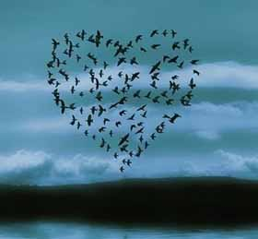
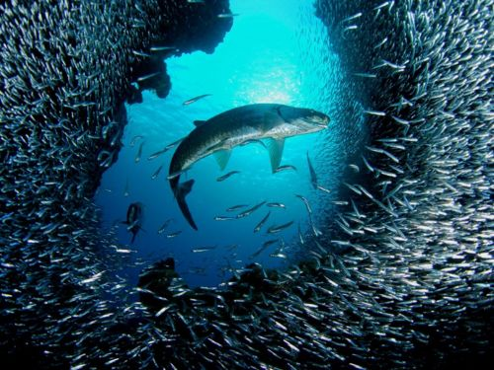
Birds & Fishes
Big coherent structure that can:
Change shape dynamically
React to stimulus
Perceive changes to the environment
Structure that:
Have a thousand eyes
Can ward of a predator
Save the individuals
Notes:
Brood: offspring

Slide 17
The 4th Principle
Adaptive Mimicking
Keep track of a limited number of neighbors
Quorum Threshold
Reliance on local knowledge
Notes:
Talk about zone of repulsion, zone of influence and zone of attraction

Slide 18
The ‘Common’ Principle
Randomness in Behavior
How ants get to that single crystal of sugar you spill: they move around randomly in search of food
How bees get a multitude of real-estate options: they wander out to random places.
How termites can repair a mound so quickly: they randomly pick a point that needs repair
How did ‘Wikipedia’ grow: random people wrote articles on random topics, and more random people edited those articles

Slide 19
The Destructive Swarm
‘Alone some of us win, together all of us win’
To
‘Alone some of us fall, together all of us fall’
crowd sourcing
swarm computing
colony optimizations
can give wonderful results, BUT…
Crowds can also turn rowdy and violent.
That is what happens in a stampede.

Slide 20
Then, why the swarm is better?
Flexible: the colony can respond to internal perturbations and external challenges
Robust: tasks are completed even if some(or many) individuals fail
Decentralized: there is no central control(ler) in the colony
Self-organized: paths to solutions are emergent rather than predefined
Information Transfer: observations about changes in the environment reach the agents at the centre of the flock in a flash

Slide 21
What is there to take away?
Local decision making: Let the one nearest to the problem make the decision.
Self-organization: If everyone did what they ought to, the world would become the perfect place.
Diversity of knowledge: A thousand eyes is better than a single pair.
Adaptive mimicking: If more than a threshold of neighbours are doing it, ‘just do it!’
Risk minimizing strategies: Nine out of ten times following the group behaviour is the right thing to do or at least a risk minimizing strategy.

Slide 22
What is there to take away?
Indirect collaboration: Build upon where the previous one left.
Friendly competition of ideas: a bit of healthy competition among ideas can compensate for the limits of human intuition.
Disagreement: with what seems wrong is as important as building a consensus for the right thing.
Effective mechanisms for narrowing choices: Bad options must be eliminated from competition as soon as possible.

Slide 23
An application: Communication Networks
Routing packets to destination in shortest time
Similar to Shortest Route
Statistics kept from prior routing (learning from experience)

Slide 24
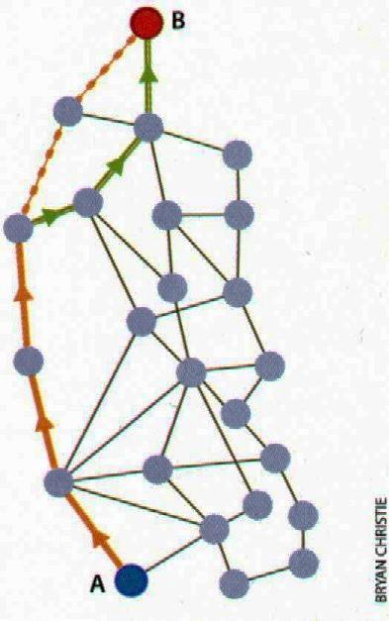
Shortest Route
Congestion
Adaptability
Flexibility

Slide 25
Dumb parts, properly connected into a swarm, yield smart results. Kevin Kelly

Slide 26

Any Questions?

Slide 27
References:
Peter Miller, The Smart Swarm.
Jeff Cobb. 10 Lessons from the Swarm, http://www.missiontolearn.com/2010/10/smart-swarm/
http://thepauls.wordpress.com/2009/04/16/lessons-from-the-ant/
http://doandroidsdance.com/features/11-edm-tracks-with-great-animal-samples/s/usual-suspects-killa-bees/
http://pitcher.tumblr.com/post/3589108449/shark#_=_
http://zidbits.com/2011/07/do-other-animals-use-a-form-of-social-networking/
http://pages.cpsc.ucalgary.ca/~jacob/Courses/Winter2000/CPSC533/Slides/06.1-Swarms.ppt
http://read.pudn.com/downloads65/sourcecode/others/231090/Swarms.ppt

